Slide 1

PmuMentor
Student Name:
Raghad Aldossary

Slide 2
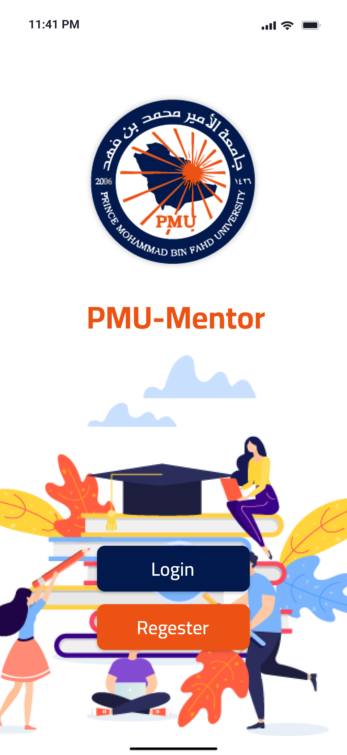
PmuMentor: Empowering Student Success through Peer Mentorship
Welcome to PmuMentor, an innovative mobile app designed to connect experienced students (mentors) with newcomers (mentees) at Prince Mohammad Bin Fahd University. This presentation will explore the features and benefits of PmuMentor, showcasing its potential to foster academic success and personal growth.

Slide 3
Introduction to PmuMentor
Vision
Mission
To create a thriving community of supportive peers who empower each other to excel academically and professionally.
To connect students with experienced mentors who offer guidance, encouragement, and resources to navigate the challenges of university life.

Slide 4

The Importance of Peer Mentorship
Academic Support
Personal Growth
Mentors can provide valuable insights on course selection, study strategies, and exam preparation.
Mentees gain confidence and develop leadership skills by interacting with experienced peers.
Campus Engagement
Peer mentorship promotes a sense of belonging and fosters a supportive campus community.

Slide 5
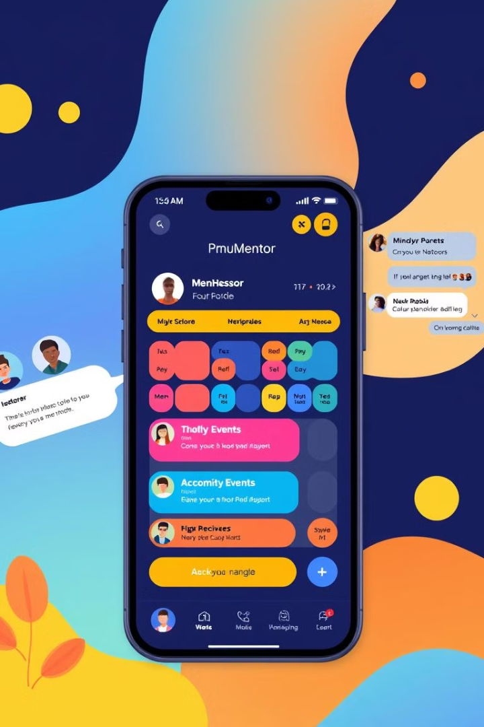
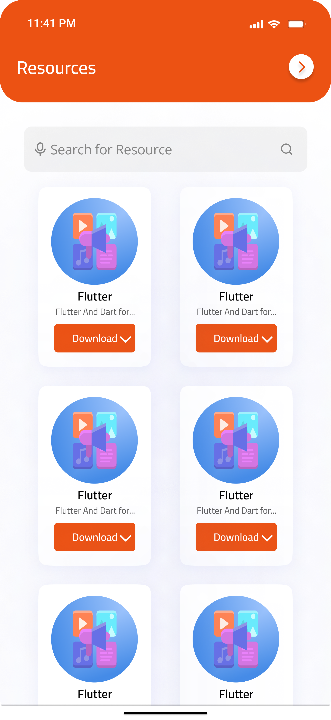
Key Features of the PmuMentor App
User Profiles
Matching Mentee-Mentor
Students can create detailed profiles, showcasing their skills, interests, and experience.
The app used to match mentors and mentees by searching for names or interests and goals.
Event Creation
Resource Sharing
Mentors can organize workshops, study sessions, and social gatherings for their mentees.
Mentors and mentees can share relevant study materials, course notes, and helpful tips.

Slide 6
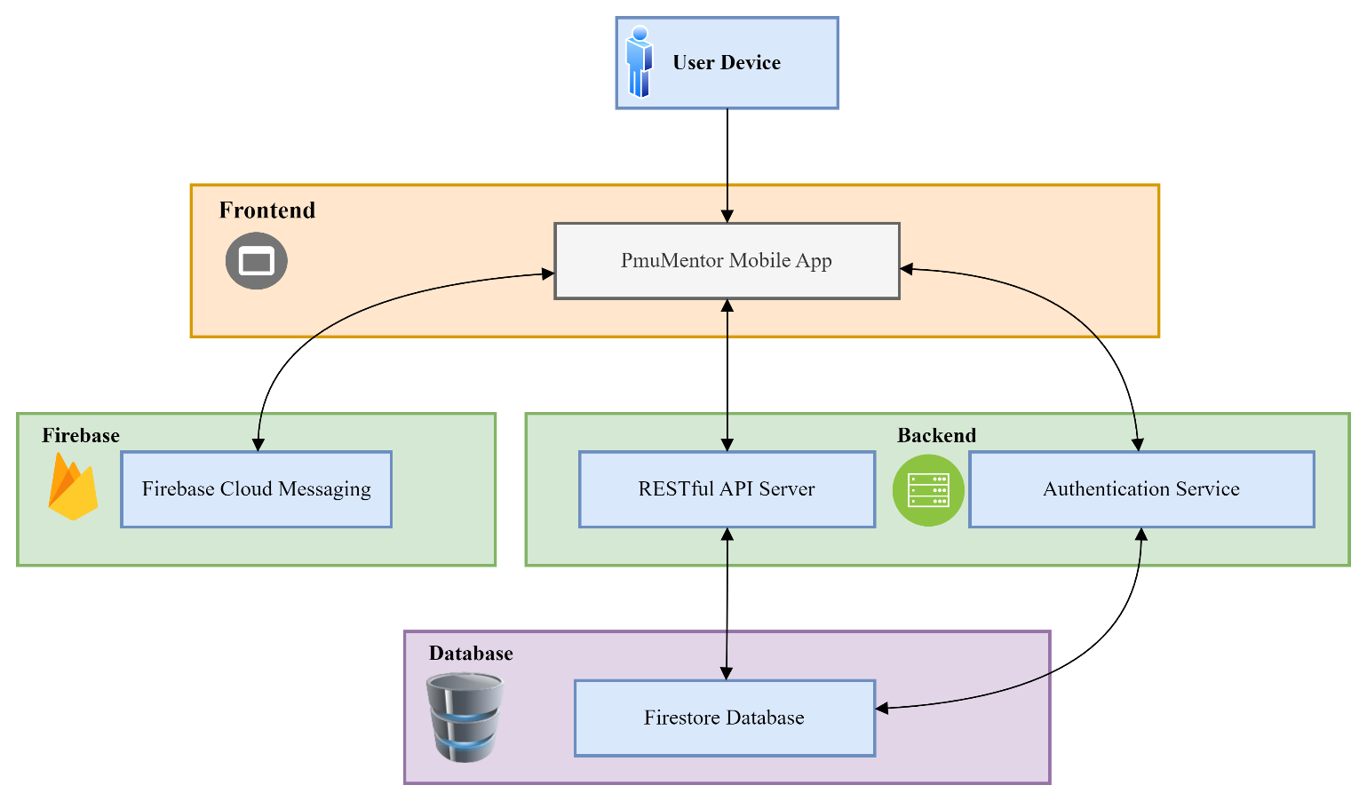
Building & Modeling System
System Architecture
The PmuMentor app is designed using a modular and scalable architecture to ensure maintainability and flexibility

Slide 7
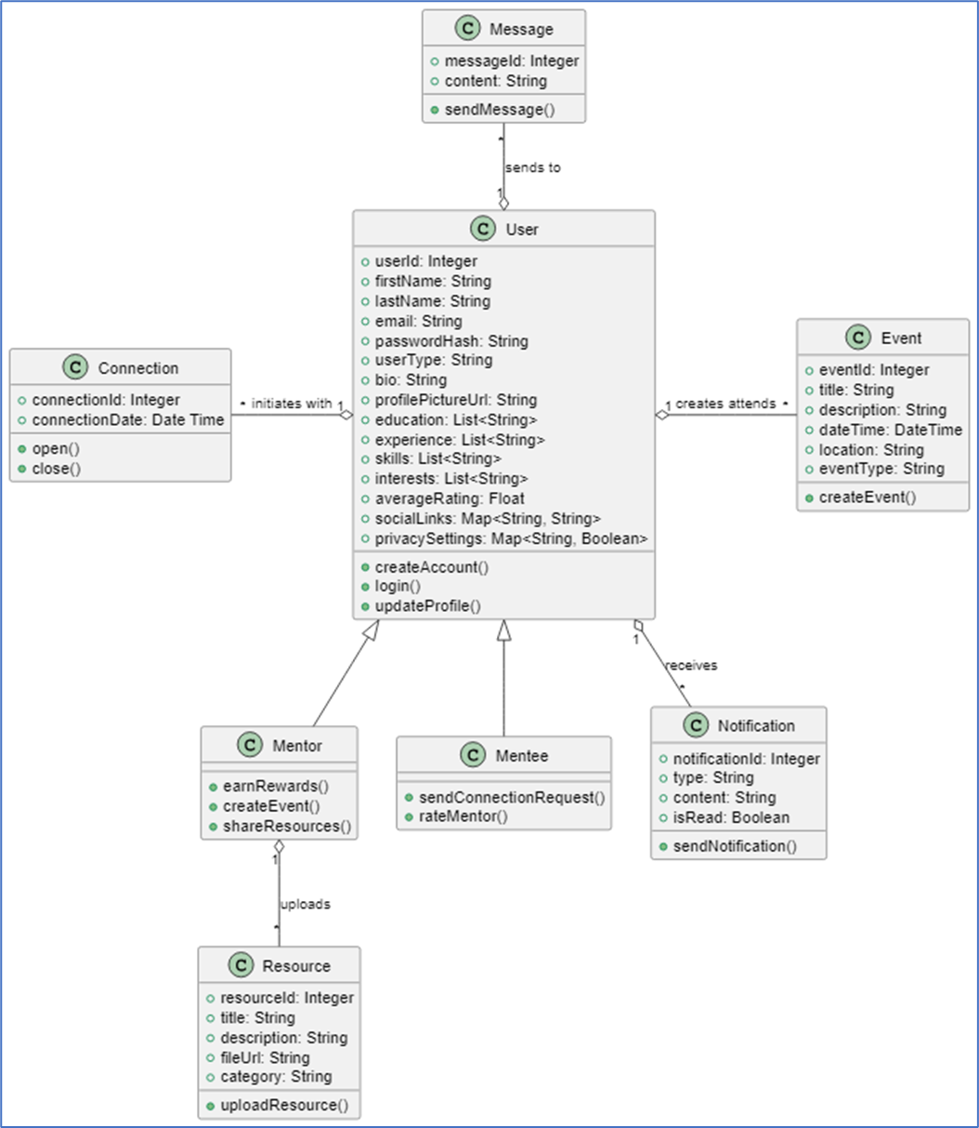
Building & Modeling System
System Design
This diagram illustrates the main classes in the system and their relationships.
The structure ensures reusability, scalability, and clear separation of concerns.

Slide 8
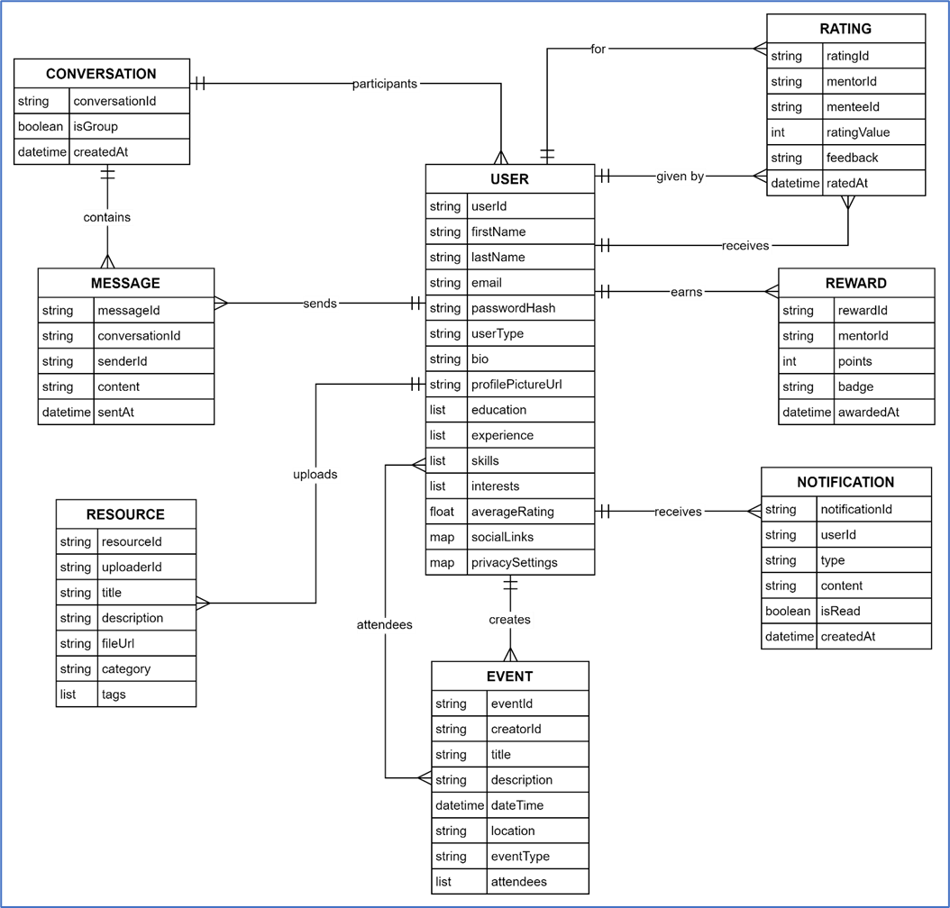
Building & Modeling
System
Database ERD
The database design ensures efficient storage and retrieval of data for users, events, resources, and communications.
It includes key entities and relationships to support the app’s functionalities.

Slide 9
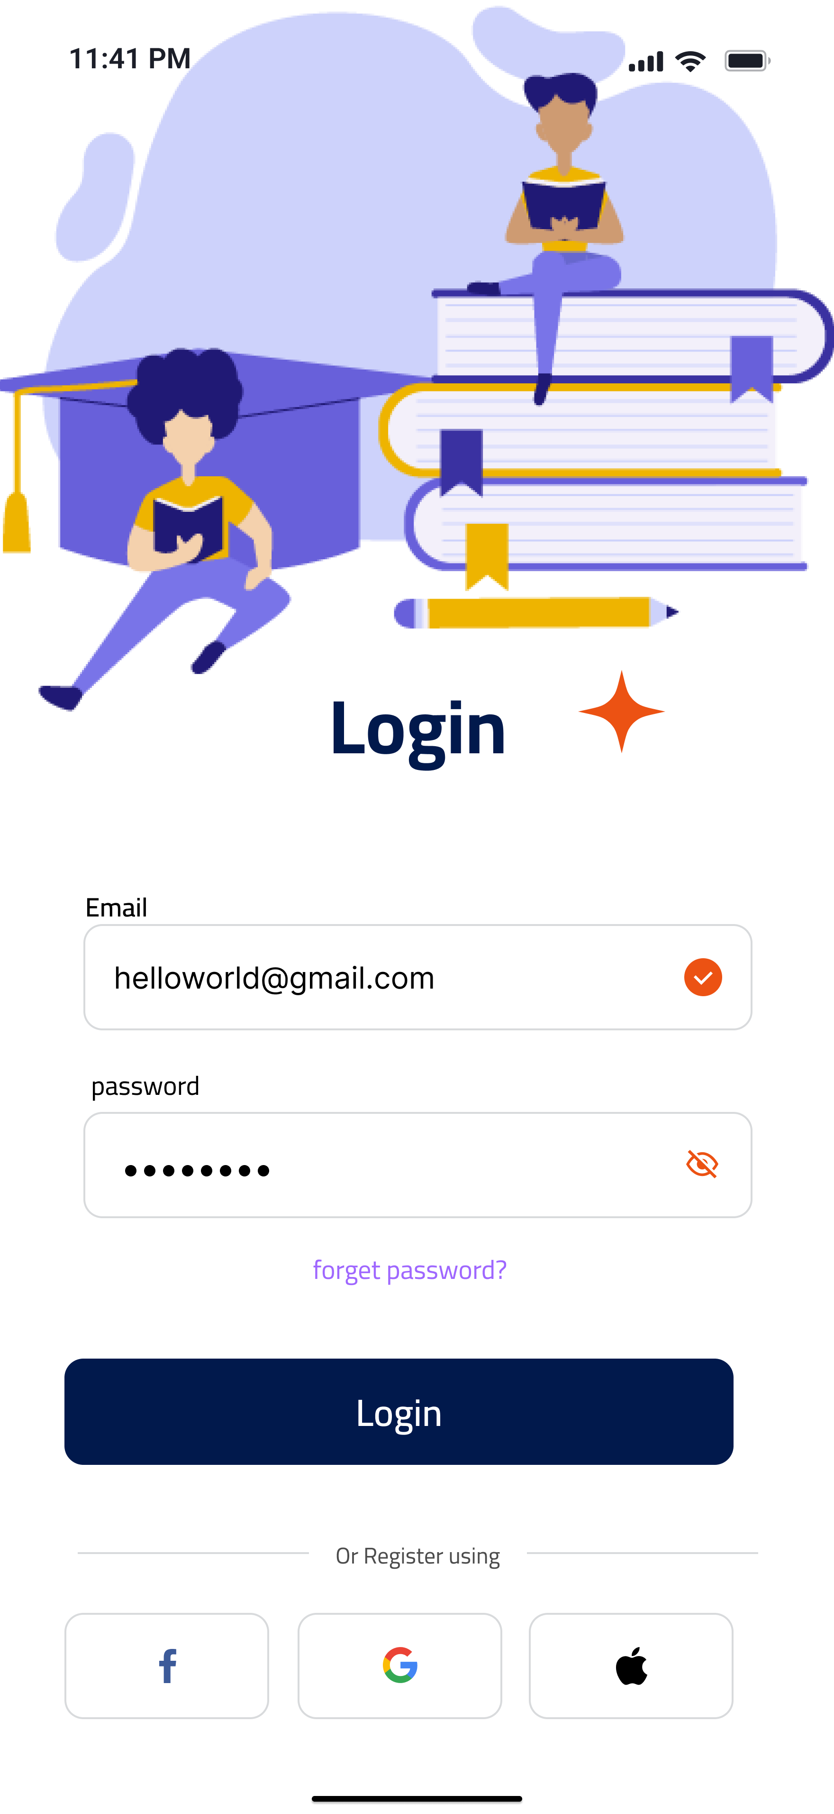
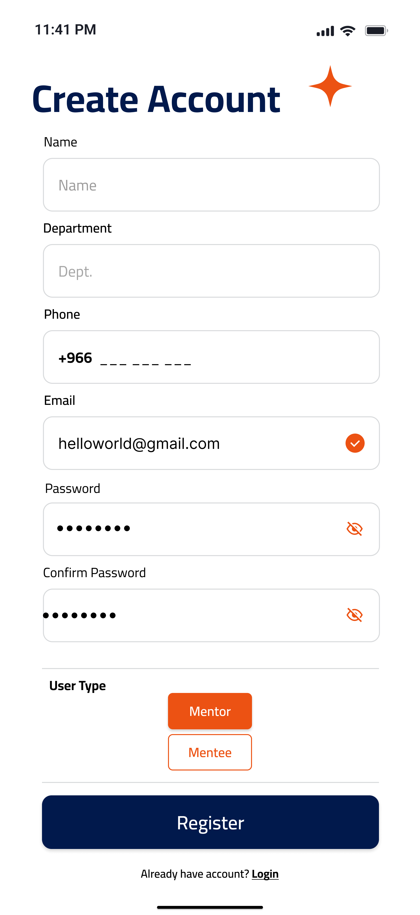
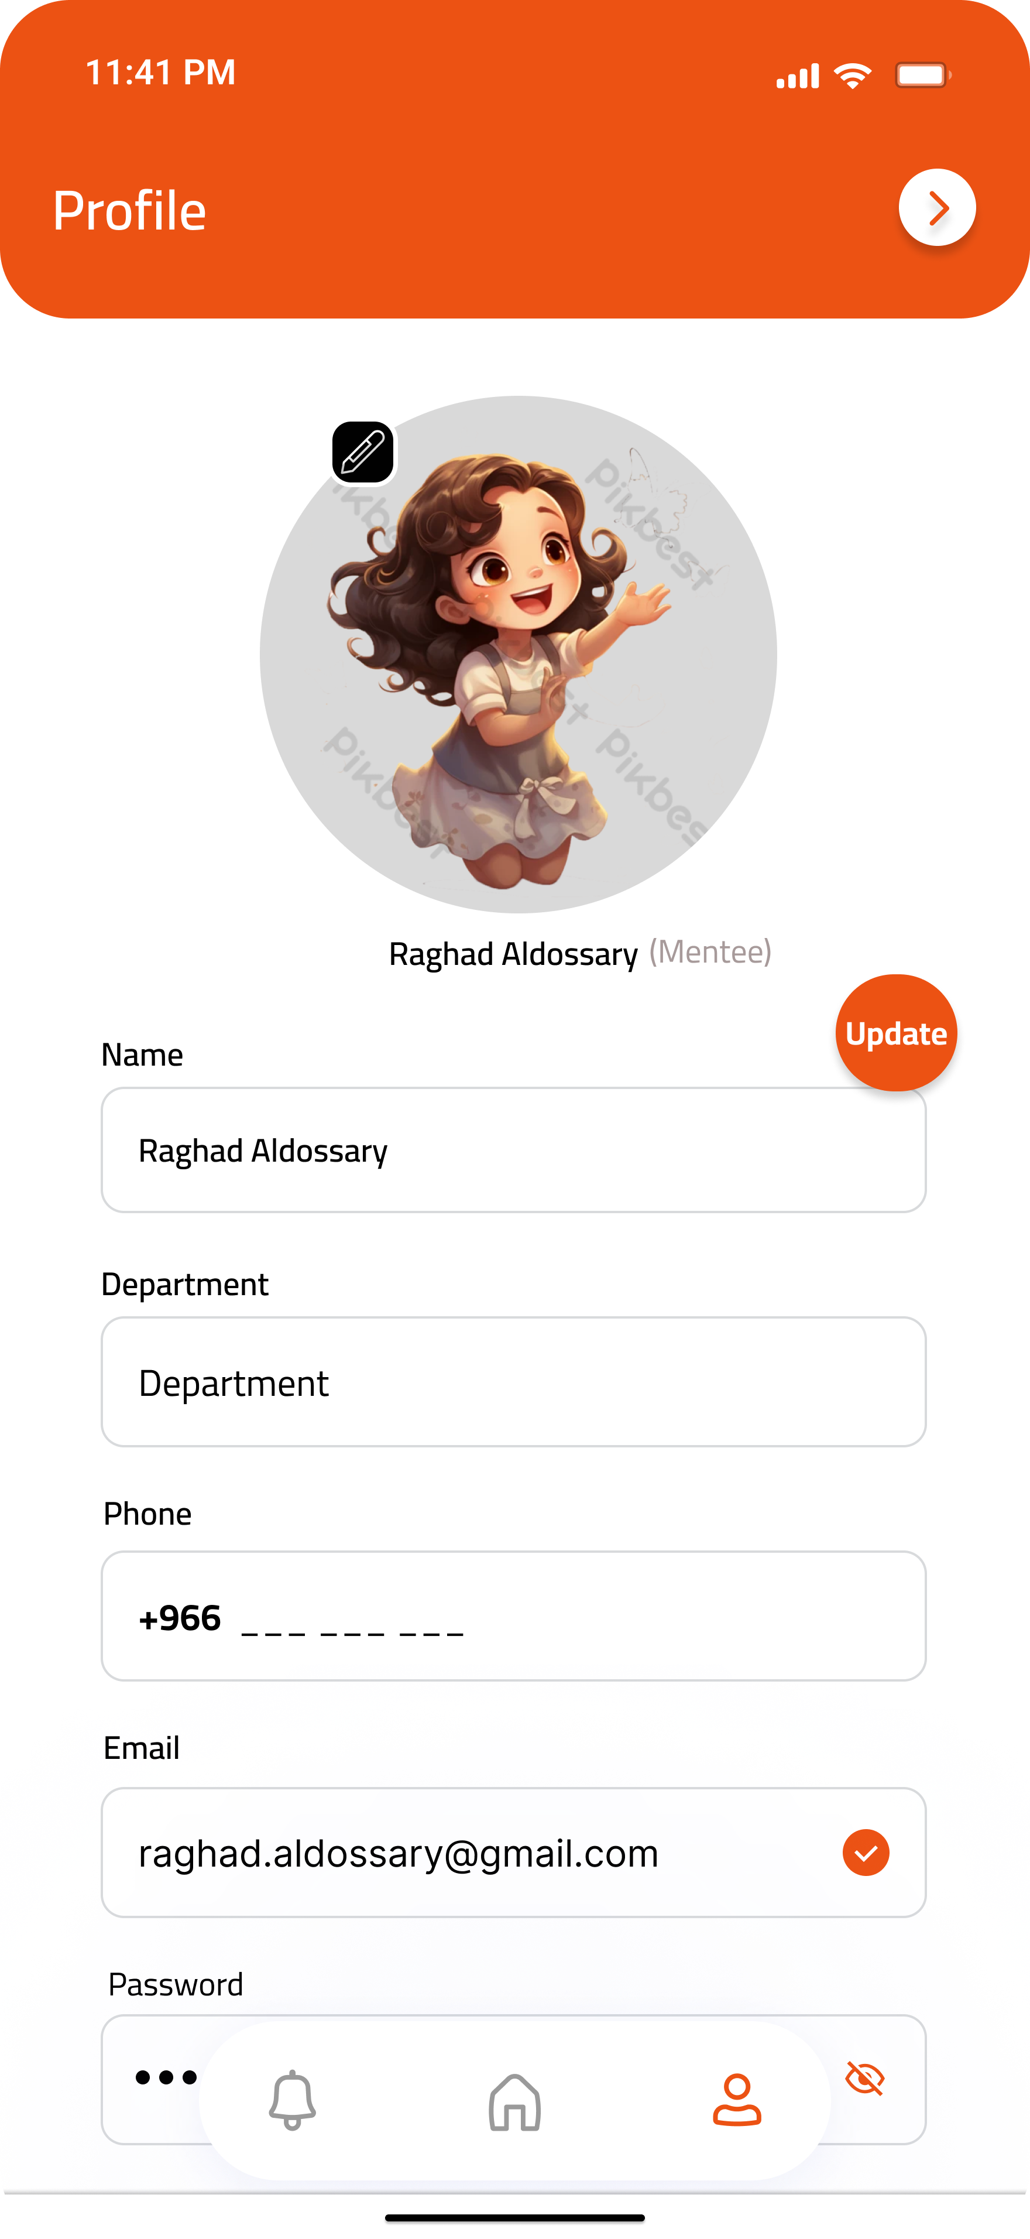
User Registration and Profile Management
Secure Login
Registration
Profile Customization
Users can easily register and log in with their university credentials.
The app allows users to register as a Mentor or as a Mentee
Students can personalize their profiles with information

Slide 10




Mentor-Mentee Matching and Collaboration
Initial Connection
Scheduled Meetings
Communicates & Chats
The app facilitates an initial introduction, providing a safe and supportive environment for mentors and mentees to connect.
Mentors and mentees can schedule regular meetings to discuss academic progress, personal challenges, and career aspirations.
The app provides a platform for ongoing communication, allowing mentors and mentees to exchange messages, share resources, and provide support.

Slide 11
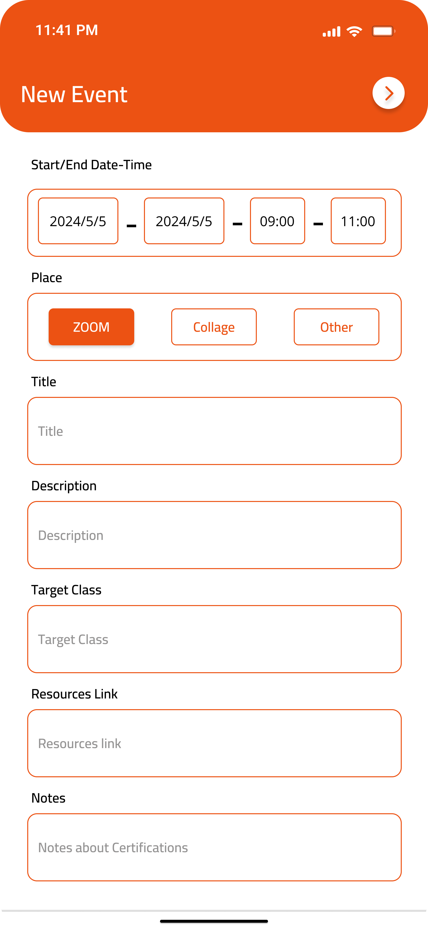
Event Creation and Resource Sharing
1
Event Planning
Mentors can create and promote events tailored to their mentees' needs.
2
Resource Repository
Mentors and mentees can access a shared repository of study materials, course notes, and other resources.
3
Knowledge Sharing
The app promotes a culture of knowledge sharing, fostering collaboration and peer learning.

Slide 12
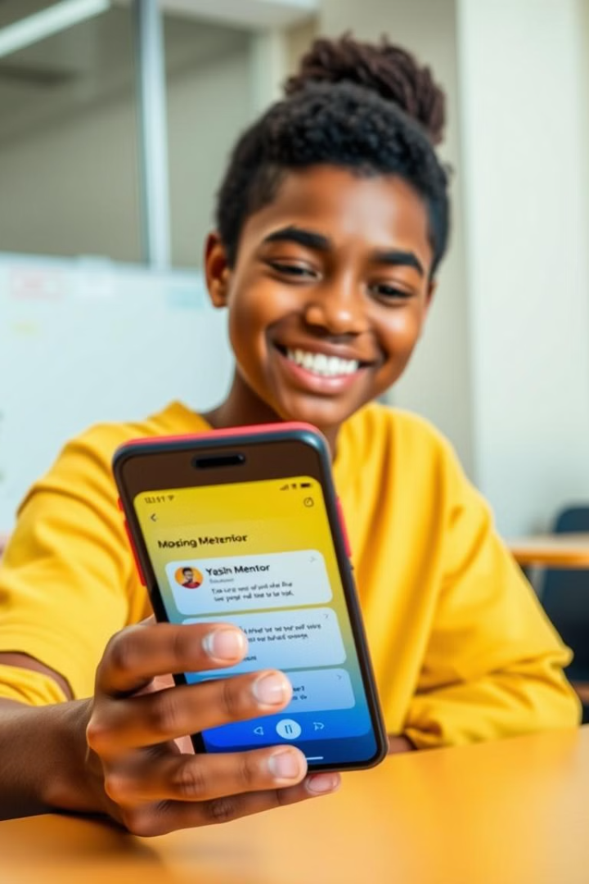



Messaging, Notifications, and Feedback
Real-Time Messaging
Mentors and mentees can communicate through the app's secure messaging system.
Personalized Notifications
Users receive timely notifications about upcoming events, deadlines, and messages.
Feedback Mechanisms
The app provides a structured feedback mechanism for mentors and mentees to share their experiences.

Slide 13
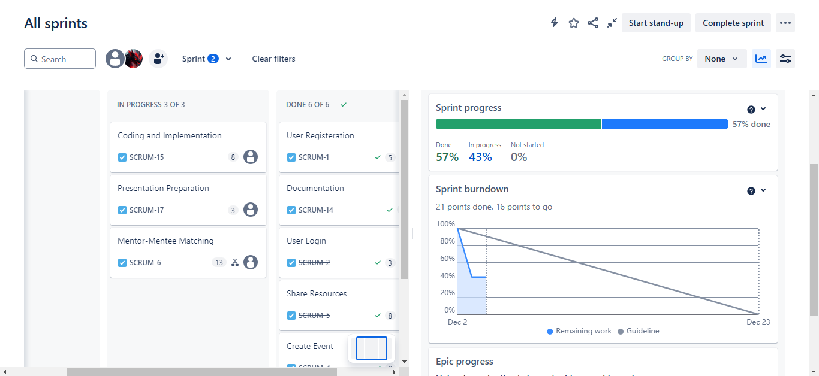
Project Management
JIRA
We use Jira to manage sprints, tasks, and user stories efficiently. Below are screenshot of the Scrum board with charts

Slide 14
Project Management
FIGMA
We use Figma to design the Interfaces

Slide 15
Conclusion
PmuMentor successfully addresses the need for a mentorship platform at PMU, fostering academic success, personal growth, and community engagement.
The project leverages Agile methodology, modern technologies, and user-focused design to deliver a scalable and impactful solution.
Future improvements aim to enhance features and expand the app’s reach within the university.

Slide 16

THANK YOU

